Slide 1
RTS preventable accidents identification
Mid-term presentation
Team 7
Notes:
Hello everyone. We are team 7 and our sponsor is RTS. We are so happy to have you here for the mid-term presentation of the RTS preventable accidents identification project.

Slide 2
Team Members
Xiaoran Li
Project Manager
Second-year MS Data Science Student
Weiran Lin
Algorithm Engineer
Second-year MS Data Science student
Melissa Chen
Algorithm Engineer
Second-year MS Data Science student
Weinan Hu
Algorithm Engineer
Second-year MS Data Science student
Notes:
To begin with, let me introduce our team members. My name is Xiaoran Li, I am the project manager who takes the responsibility for communicating with stakeholders, scheduling resource, and controlling. My team members Weiran Lin, Weinan Hu, and Melissa Chen are all algorithm engineers, contributing a lot to data processing, statistical analysis and modeling.

Slide 3
Agenda
Introduction
Milestone
Data Science
Feedback
Documentation
Outlook
Notes:
Now, let us see today’s agenda. Our presentation contains 6 parts. Firstly, we will have a project introduction and tell you what problems are we solving. Secondly. We will go over the milestone and track progress. Then, we will showcase the lasted work in the data science part. After that, we will share feedback from sponsors, presenting our documentation, and have an outlook for the rest part of the work.

Slide 4
Introduction
1
Notes:
First, Introduction

Slide 5
Vision & Goals
Vision
Reduce future preventable accidents and improve safety.
Goals
Identify potential causes of preventable accidents.
Deliver reusable models to predict future preventable accidents.
Notes:
In each of the last 5 years RTS has consistently had approximately 100 preventable accidents of varying severity. Since that, we want to reduce future preventable accidents and improve safety. Our goals are identifying potential causes of these preventable accidents and deliver reusable models to predict future preventable accidents.

Slide 6
Techniques
Confusion Matrix is a performance measurement for machine learning classification problem where output can be two or more classes.
AUC - ROC curve is a performance measurement for classification problem at various thresholds settings.
Autoregression is a time series model that uses observations from previous time steps as input to predict the value at the next time step.
CNN In deep learning, a convolutional neural network (CNN, or ConvNet) is a class of deep neural networks, most commonly applied to analyzing visual imagery.
Notes:
The techniques we will mention include confusion matrix, AUC-ROC, autoregression, and CNN. We will explain simply and clearly that people of all levels can easily follow.

Slide 7
Progress
Project Assigned
09/21
Presented our plan to sponsor
09/28
1st presentation. Signed the project charter + presented progress
10/14
Midterm Presentation
2nd Presentation with sponsor
10/26
Notes:
We were assigned this project on 09/21, we took a week to draft our first version project charter on 09/28 and presented it to sponsors via email. After a few meetings with professor P.J., we finalized our project charter. On 10/14, we held the first zoom meeting with sponsors, signed the charter, and presented our progress. Today, 10/26th is the 2nd time to present our outcome to sponsors also with all of you.

Slide 8
Next Presentation
10/14
1st
11/11
3rd
12/09
5th
Bi-Weekly
10/26
2nd
(Mid-term)
11/25
4th
Notes:
We will hold bi-weekly meetings with sponsors afterwards. The next time would be on 11/11th. And after that, the 4th one would be on 11/25th and the last one on 12/09.

Slide 9
Milestone
2
Notes:
Second, Milestone

Slide 10

Milestone
 | Content | Anticipated Date | Actual Date
Milestone 1 | Create Project Charter | 10/09 | 09/28
Milestone 2 | Data gathering and merging | 10/16 | 10/14
Milestone 3 | Data cleaning and explanatory analysis | 10/30 | 10/25
Milestone 4 | Feature engineering | 11/13
Milestone 5 | Develop predictive models | 11/27
Milestone 6 | Conduct causal analysis | 12/04
Milestone 7 | Complete final presentation and delivered result | 12/09
Notes:
We have 7 milestones in total and we have completed the first 3 so far. We created and signed the project charter. We gathered all the internal and external data and merging them together. This week, we completed the data cleaning and explanatory analysis. Currently, we have started feature engineering and predictive modeling and we have the confidence to complete them on time.

Slide 11
Data Science
3
Notes:
Third, Data Science

Slide 12
Business Understanding
Take actions
Improve the quality of service
decrease cost
avoid unnecessary injuries and damages
Identify + prediction
Notes:
Let me introduce the business understanding first. In recent years, consistently preventable accidents reduced service quality in RTS. We want to identify the underlying causes of preventable accidents and develop models to predict these accidents beforehand. With this information, RTS can take effective actions to reduce future preventable accidents. In this way, RTS can improve the quality of service, decrease cost. And more importantly, avoid unnecessary injuries and damages.

Slide 13
Dataset
Street SpeedLimit
Age Distribution
Age
RTS Accident
Date & Time
Address
Operator
Road Condition
...
Traffic Accident
Date & Time
Location
Road Condition
Weather
...
Absence
Operator
Date
...
Lat, Lng
Operator
Days Off
Operator
Date
...
Timeline Analysis
Geolocation Analysis

Slide 14
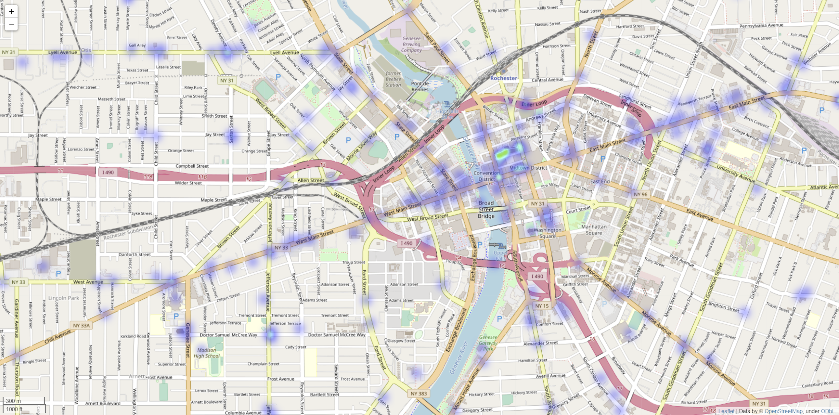
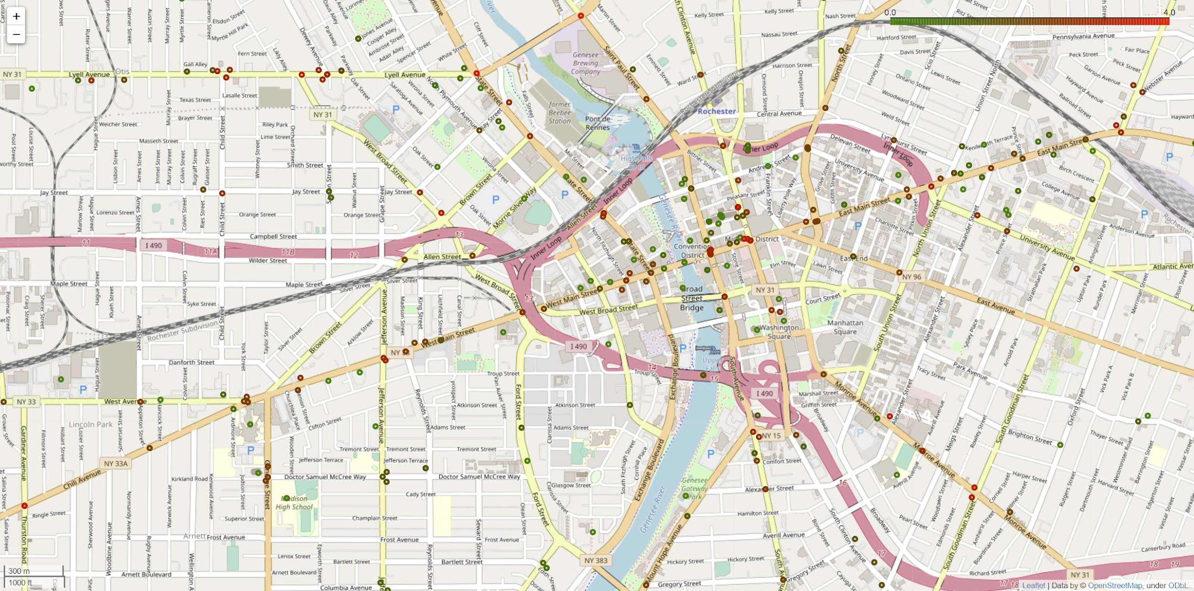
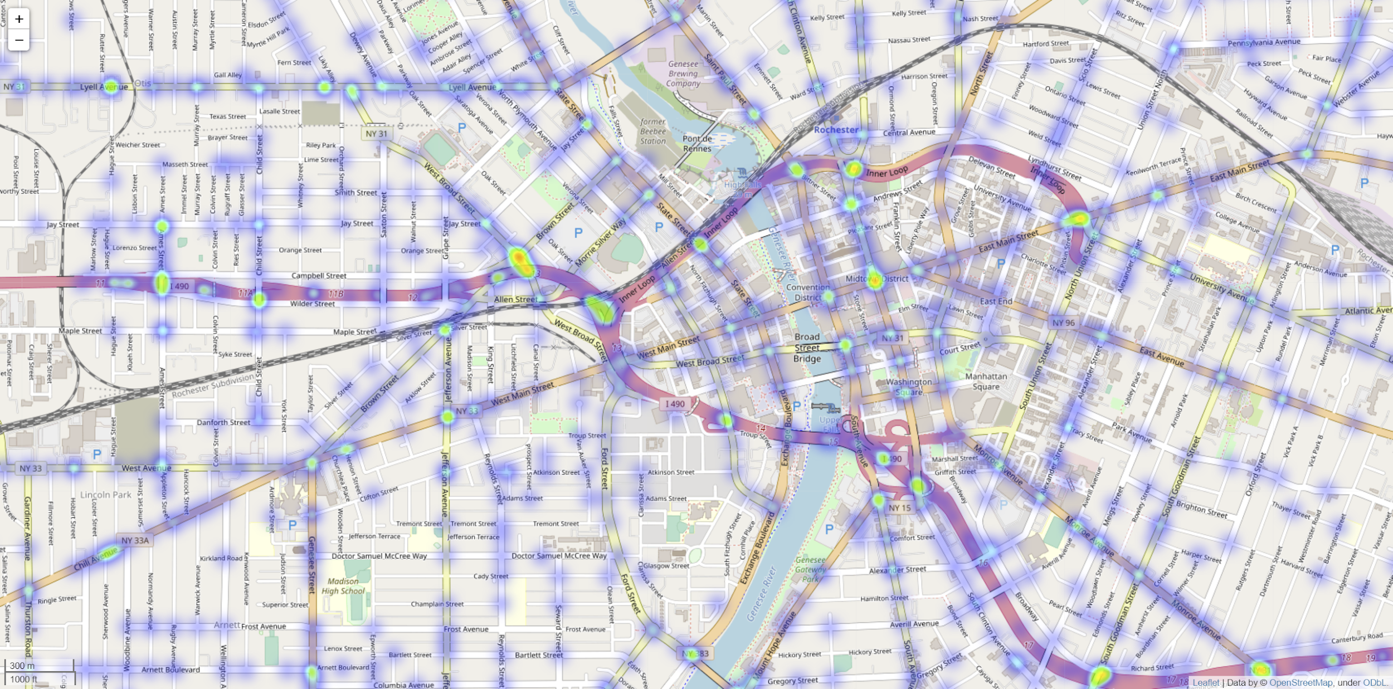
Geolocation Analysis - RTS accidents map
+
Lay them together:
Each dot for RTS accidents
Color for ALL accidents
Heatmap for RTS accidents
Heatmap for all vehicle accidents
Notes:
Animations

Slide 15
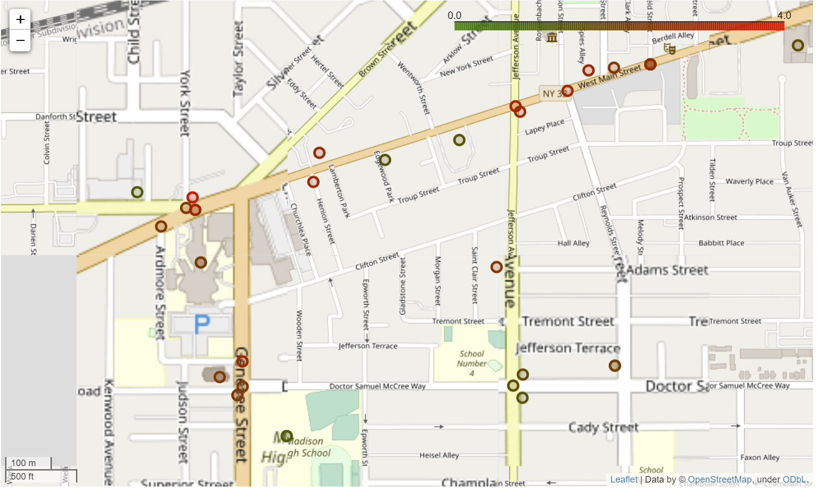
Geolocation Analysis - RTS (buses) vs ALL vehicles
Each point: An RTS accident
Red: Many ALL accidents
Accident Hotspot?
Bad road design?
Green: No other accidents
Something related to RTS?
Bus longer?

Slide 16
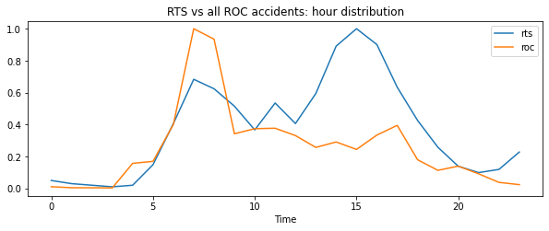
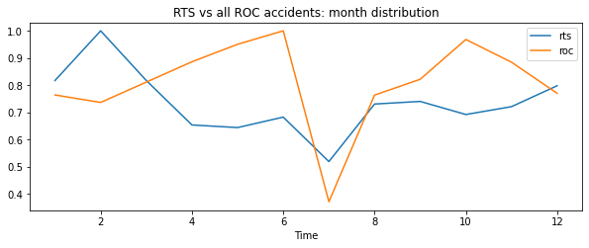
Time & Seasonality - RTS (buses) vs ALL vehicles
Hour distribution
RTS accidents
All vehicle Accidents
- ‘Peak’ in the afternoon
- A lot more accidents in the winter
Midnight Dawn Morning Noon Afternoon Evening Midnight
Month distribution
Jan Mar May Jul Sept Nov

Slide 17
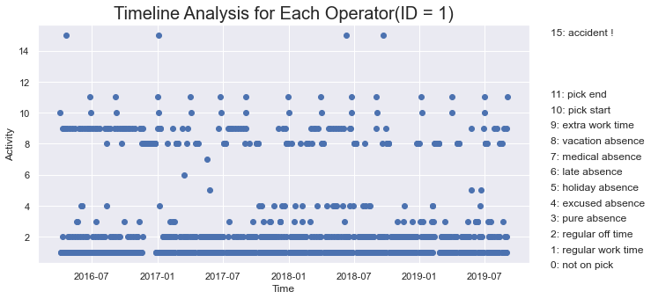
Timeline Analysis
Timeline range from 2016-04-04 to 2019-09-02
Operators have different timelines
Timelines as features

Slide 18
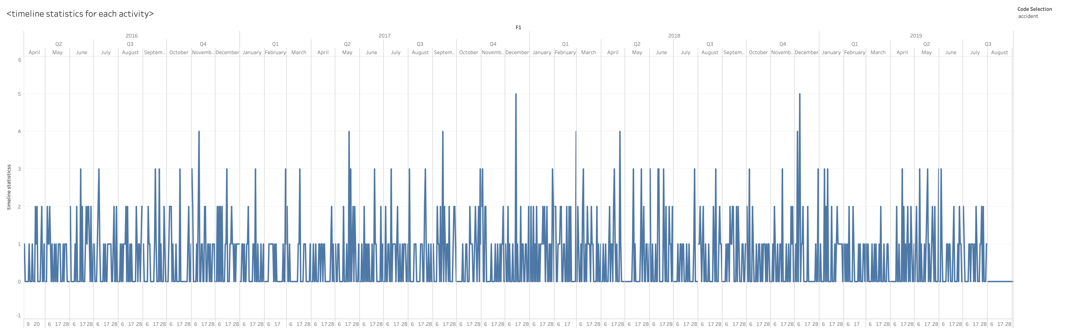
Timeline Analysis
Q4
Q4
Q4
Accident statistics on all operator
Seasonal patterns

Slide 19
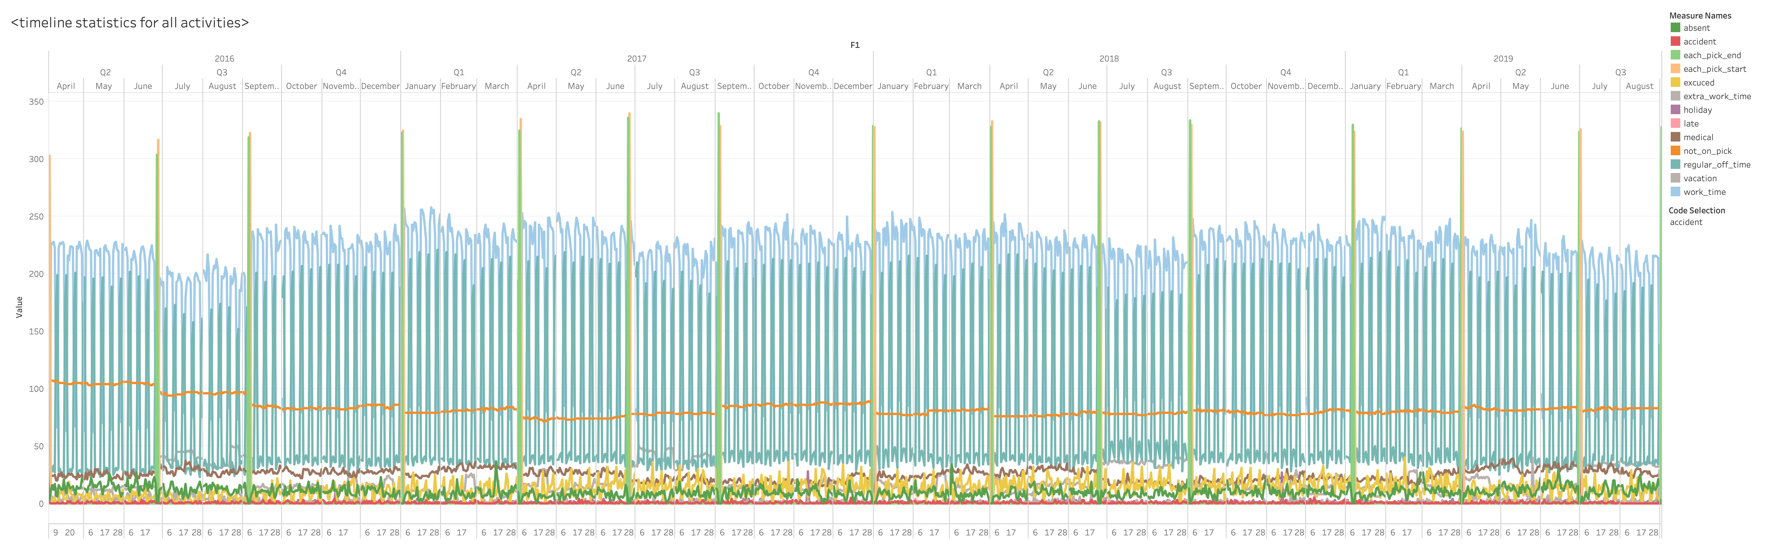
Timeline Analysis
Statistics on all activities
Time lag patterns

Slide 20
Lag Variables - Definition
Two ways of definition
Time lag of each activity(activity fixed)
Domain knowledge
Frequency of absence/extra work of certain time period
(time lag fixed)
lag
Timeline
Pick start medical vacation late accident date
Timeline
Two month ago one month ago one week ago accident date

Slide 21
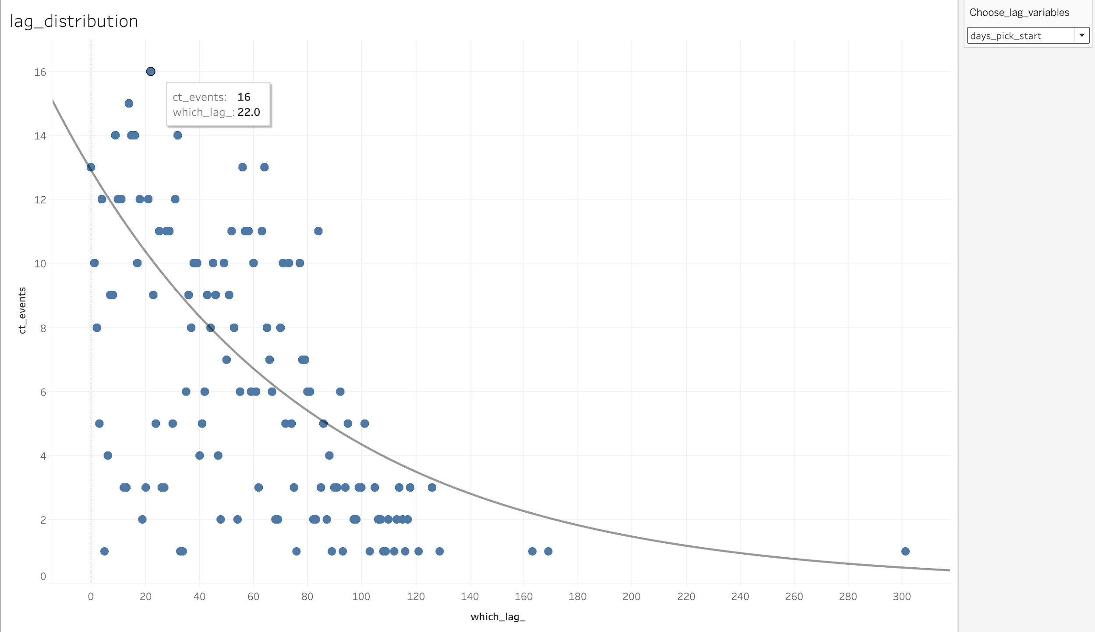
Lag Variables - Visualization
Pick start time lag is significant
Exponential decay

Slide 22
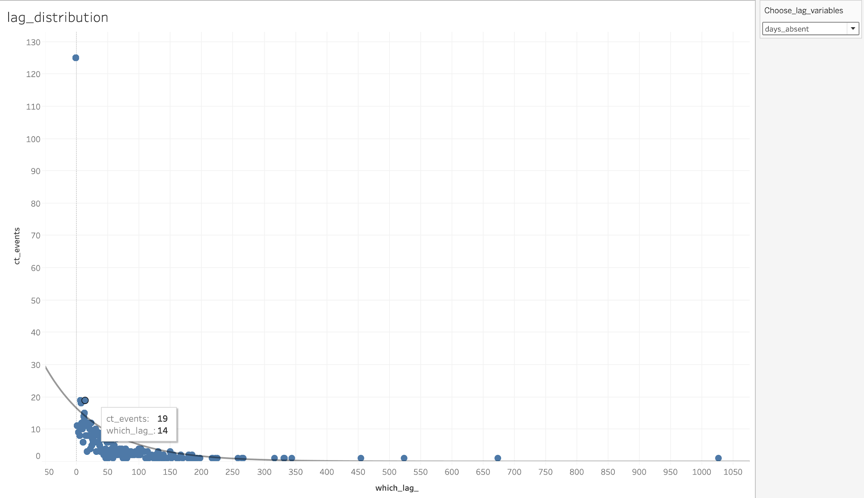
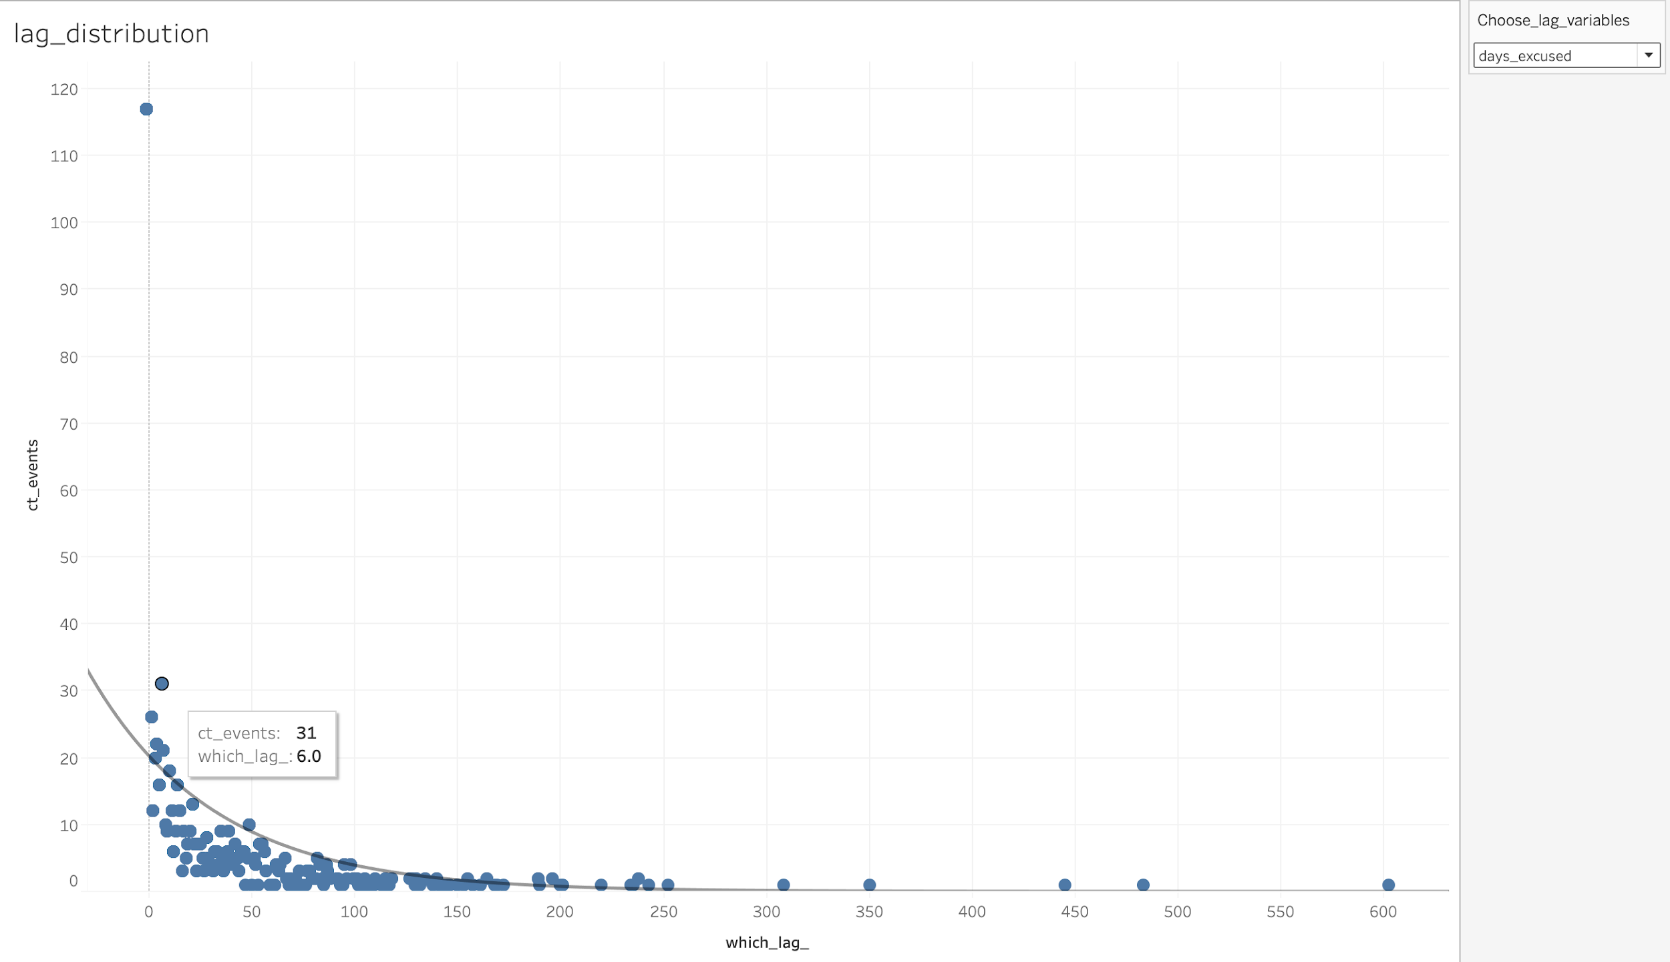
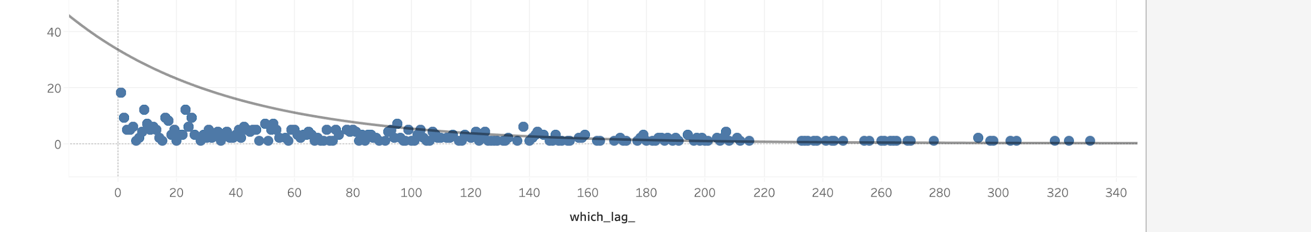
Lag Variables - Visualization
Significant lag variables are:
absence lag
Excused lag
Vacation lag

Slide 23
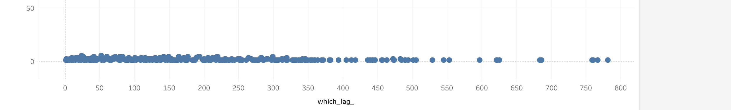
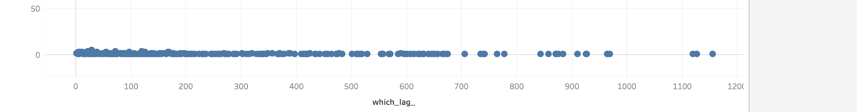
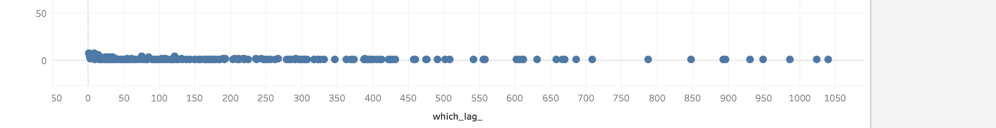
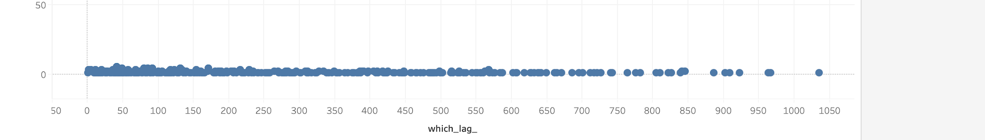
Lag Variables - Visualization
Insignificant lag variables are:
Holiday lag
Late lag
Medical lag
Last accident lag

Slide 24
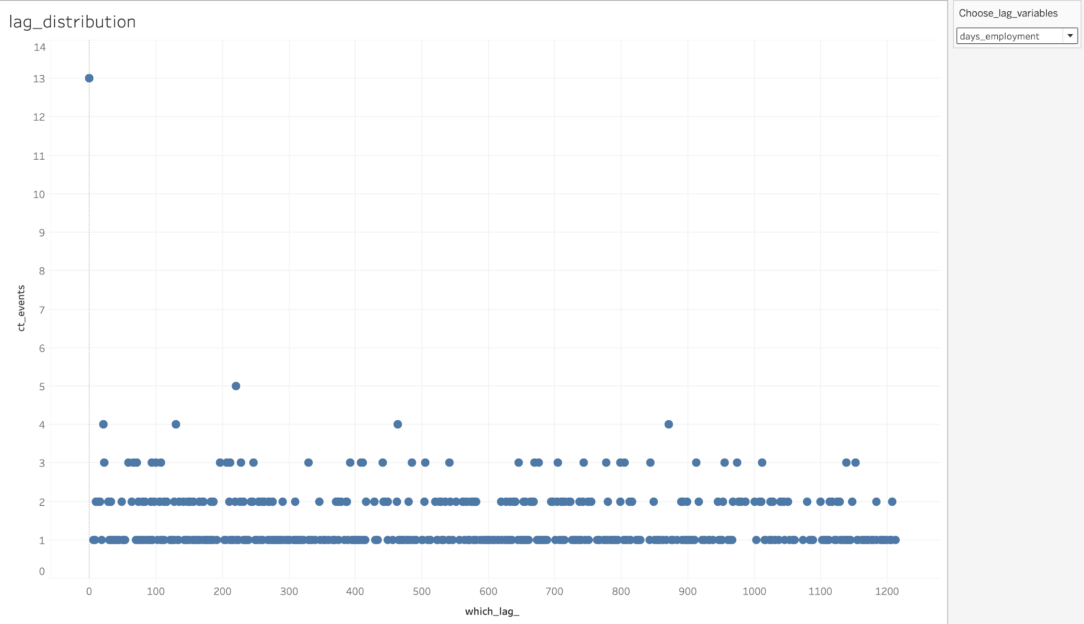
Lag Variables - Visualization
Insignificant lag variables are:
Employment lag

Slide 25
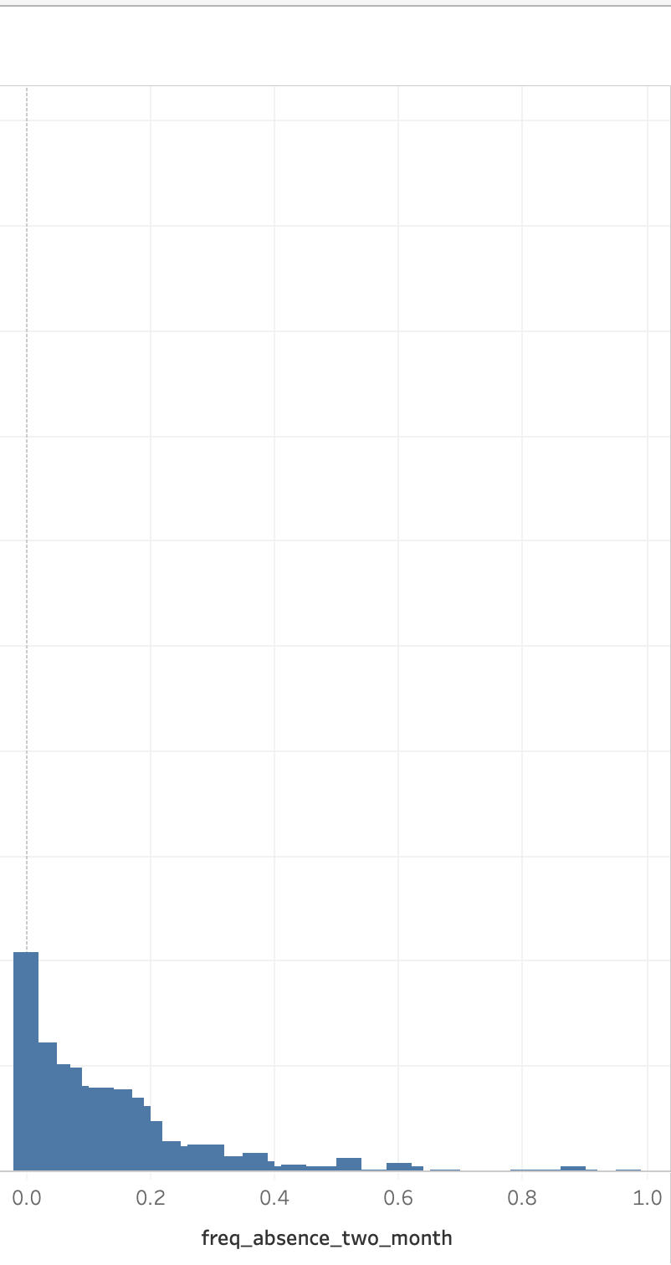
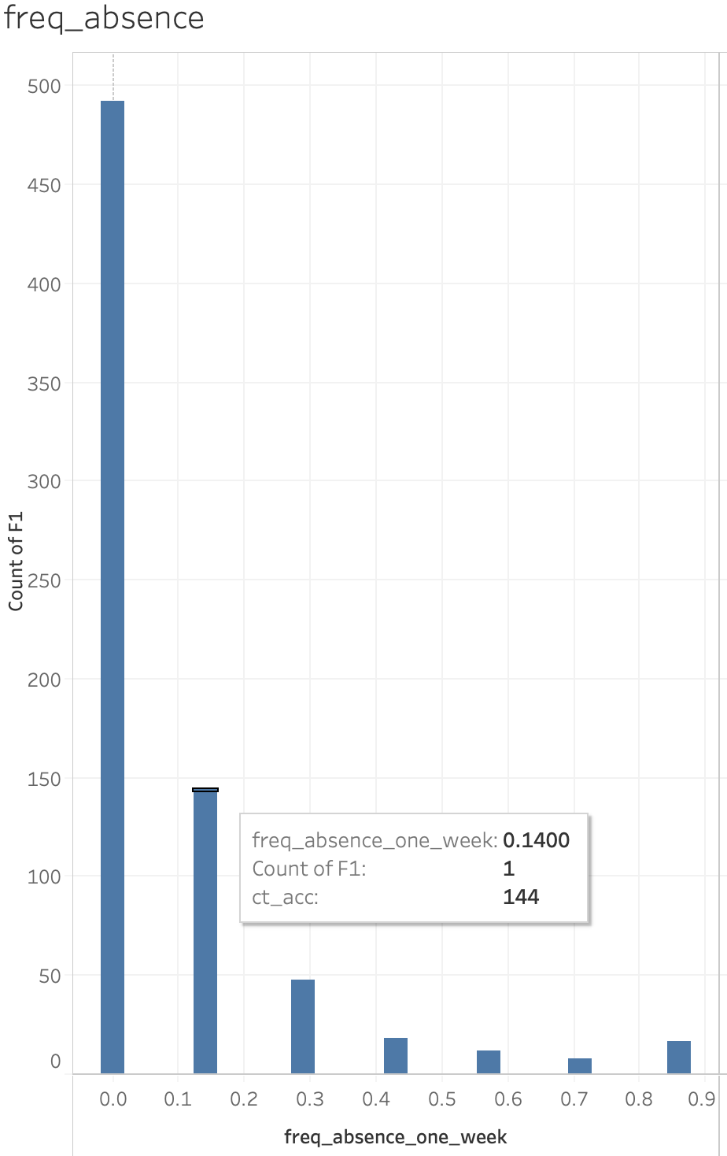
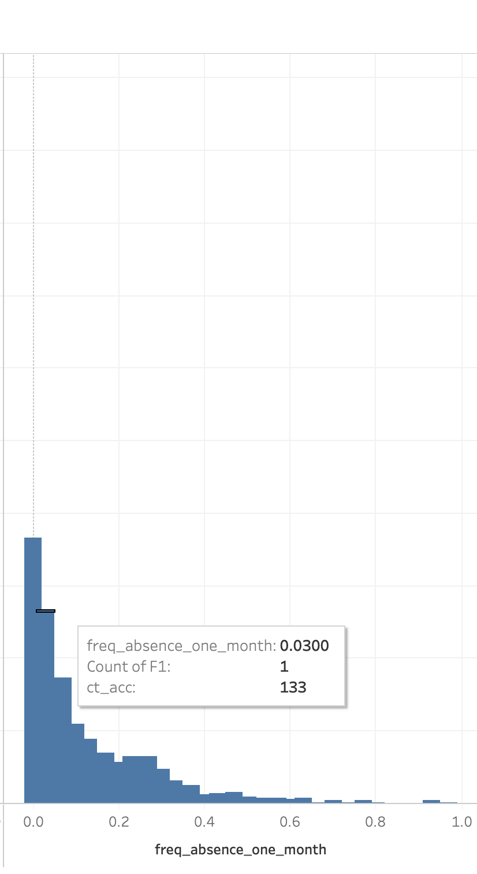
Lag Variables - Visualization
The frequency of all absence types prior certain time periods are significant

Slide 26
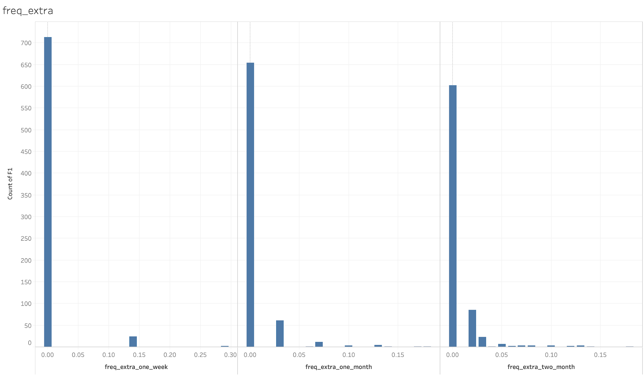
Lag Variables - Visualization
The frequency of overtime work prior certain time periods are significant

Slide 27
Lag Variables - Selection
Meanings
Identify patterns from accidents
Find good indicators for accidents
Fit significant variables in the model

Slide 28
A mighty predictive deep learning model
Correspond with real-life application
Predict use only operator data
Autoregressive
Flexible input/output & accurate prediction
input width = 32
output width = 10
t = 0
t = 1
t = ...
t = 32
t = 33
t = ...
t = 42
total width = 43

Slide 29
A mighty predictive deep learning model
SO FAR
Data preprocessing
Model coding(Python, tensorflow)
Fix-length input training
NEXT
Model architecture improvement
Flexible length input/output
More experiments

Slide 30
Upcoming……
Modeling and and statistical methods
Correlation between variables and accidents (Bayesian Network)
Predictive modeling (traditional models)
Models evaluation
Confusion matrix
ROC and AUC
Accuracy
Notes:
Thank you Melissa and thank you Weinan and Weiran, for sharing our lasted progress. Our next step is modeling and statistical methods, including correlation between …

Slide 31
Feedback
4
Notes:
Now let us come to our fourth part, Feedback

Slide 32
- Great work overall so far.
- The reusable methods and models is what RTS want for quality assurance.
- The way of data visualization and geoinformation analysis is good.
Notes:
We got feedback from both email and zoom meeting from our sponsor. They regard our work as great overall. Particularly, they said the reusable methods in our deliverables are what they want because this will have long-term benefits for improving the service quality in RTS. Also, they like the way of our visualization and geoinformation analysis.

Slide 33
Documentation
5
Notes:
Fifth, Documentation

Slide 34
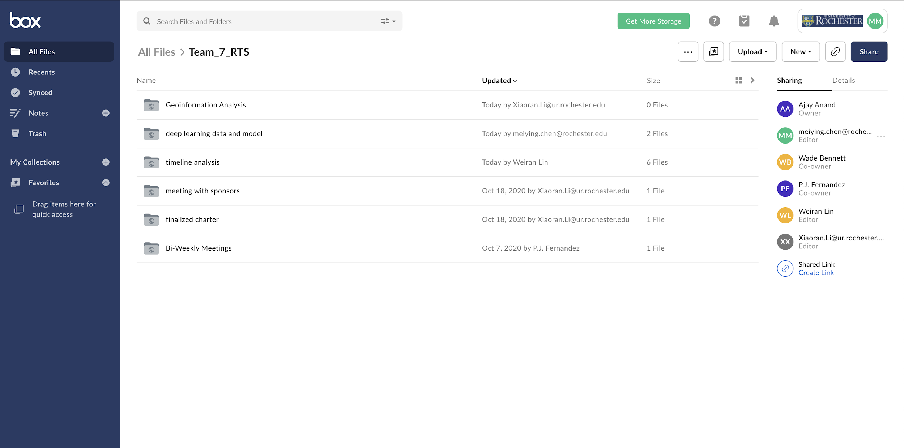
BOX
Resource Sharing
- Data, Dashboard, Code, Graph, Video
- Share outcome from team members
- Resource from professors
Place your screenshot here
Notes:
We use BOX for resource sharing, each team member uploads their progress on BOX and complete the work handover. The formate including data, dashboard, code, graph and video. We also get resource from professors from BOX.

Slide 35
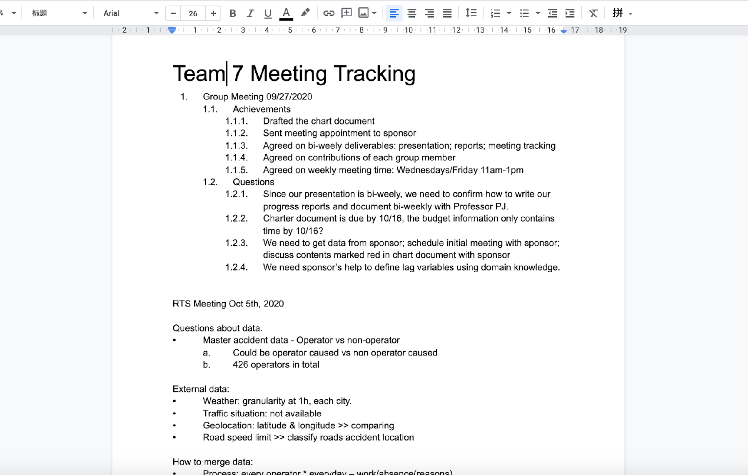
Google Docs
Internal Meeting Recording
- Text files
- Record brainstorming ideas
Notes:
Our second website is google docs. The first reason is for internal meeting recoding since we don’t want to miss any great ideas in the brainstorming.

Slide 36
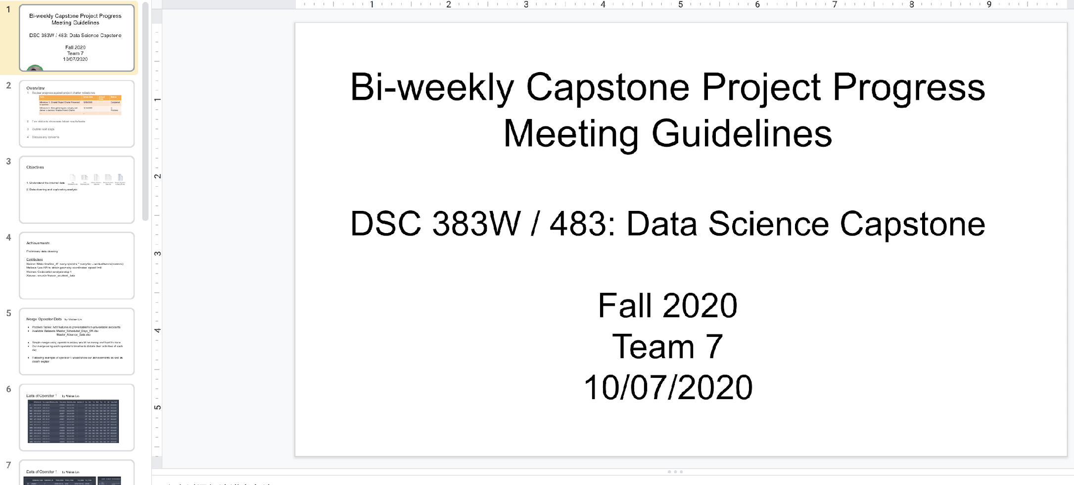
Google Docs
PPT Collaboration
- PPT files
- Work out together for each presentation with professor or sponsor
Notes:
The second reason is PPT collaboration. We worked out slides together before each presentation.

Slide 37
Outlook
6
Notes:
Sixth, Outlook

Slide 38
Outlook
😉
Ahead of the original schedule
Overcame challenges
Stay closely with our sponsor
We Will - Finish the project on schedule
- Achieve the expectations of RTS
Notes:
By now, we are always a few days ahead of the original schedule in each milestone, we overcame challenges in many ways, we also stay closely with our sponsors to track our progress better. So, we have the confidence to finish the project on schedule and achieve the expectations of RTS.

Slide 39
THANKS!
Any questions?
Notes:
It is so lucky and happy to be the first in the mid-term presentation. Thank you so much for your time! Thank

